Slide 1
English for Engineering
Unit 3
Components and Assemblies
Dr. James Slawney

Slide 2
Describing Component Shapes and Features (p 22)
Important vocabulary:
layout = Anordnung
lay out = ausbreiten, anlagen, planen
profile = Profil
configuration = Konfiguration
circular = kreisförmig, rund
rounded = rundlich
rectangular = rechteckig
cylindrical = zylindrisch
linear = linear, geradlinig
triangular = dreieckig

Slide 3
Describing Component Shapes and Features (p 22)
Component => an individual part, such as a wheel of a car
Assembly => a number of components that have been put together / assembled. For example, a car engine is an assembly, assembled from hundreds of components such as pistons, shafts, electronic components, etc.
Shapes = > a geometric shape such as a circle, square, etc.
Feature => a characteristic or a focal point of an object. For example, a CD disc has the feature that it has a hole in it.

Slide 4
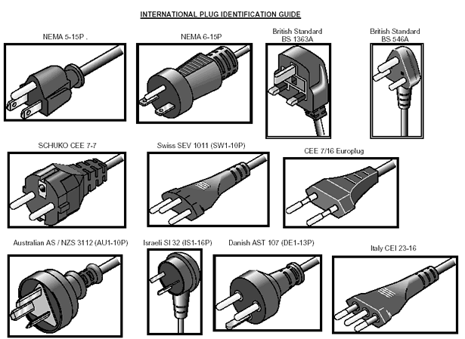
Describing Component Shapes and Features (p 22)

Slide 5
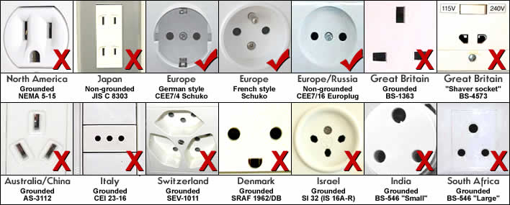
Describing Component Shapes and Features (p 22)

Slide 6
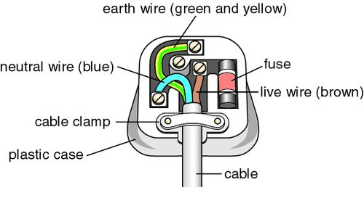
Describing Component Shapes and Features (p 22)

Slide 7
Describing Component Shapes and Features (p 22)
2b)
DISCUSSION
What is meant by „profile of the pins“ and „standard configuration“?
The profile of the pins means the shape of the individual pins, for example, a rectangular cross-section or a circular cross-section.
A standard configuration means a uniform arrangement, for example in a given country all plugs have a standard layout—they are all exactly the same.

Slide 8
Explaining and Assessing Manufacturing Techniques (p 24)
Useful vocabulary:
Drill = Bohrmaschine
Mill = Mühle
Saw = Säge
Shear = Schere
Flame-cut
Grind = zerkleinern, zermahlen
Cast = Gußform
Hammer = Hammer
Guillotine = Guillotine, Fallbeil
Punch = Locher
Hole-saw = sägen durch ein genachte Loch
Toothed blade = gezahnte Klinge
Abrasive wheel = Schleifkörper
Cutting wheel = Schneidenrad
Kerf = Kerbschnit

Slide 9
Explaining and Assessing Manufacturing Techniques (p 24)
More Vocabulary:
Hardness = a material’s resistance to abrasion
Toughness = a material’s resistance to breaking when subjected to tension (stretching) or bending
Thermal properties = a material’s characteristics at different temperatures
Thermal stability = a material’s ability to behave consistently at different temperatures (important because cutting processes such as sawing and grinding generate heat, which can camage thermally sensitive materials).
Electrical properties = a material’s ability to conduct electricity and its behaviour when an electric current passes through it ( important because some cutting processes use an electric arc only suitable with materials that are effective electrical conductors—i.e. metals.)
Edge quality = the degree of smoothness of the edge of a material after it has been cut (important because some techniques produce smoother cuts than others)
Production volume = the amount produced (usually by a factory) (important because some cutting techniques are relatively time-consuming, making them unsuitable for mass-production)
Cutting wheel = an abrasive or toothed wheel designed to cut materials (not that milling machines use toothed metal cutting wheels to progressively shave thin layers of metal from the surfaces of components producing “swarf” = metal shavings produced by milling machines)
Grinding = using an abrasive wheel to grind away the surface, producing hot particles of molten metal due to heat from friction in the form of sparks
Combustible = can be burned

Slide 10
Explaining and Assessing Manufacturing Techniques (p 25)
ANSWERS
7a)
Secondary operations = additional machining, such as polishing
Net-shaped parts: parts which accurately cut edges: often intricate shapes
Heat-affected zone: the area modified by high temperatures (resulting from the heat of cutting)
Mechanical stresses = physical forces such as shear forces when sawing or guillotining metal
Narrow kerf = narrow thickness of material removed during cutting; especially easy to do with waterjet cutting
Tightly nested = when several components are cut from the same piece of material the components can be placed close together, making better use of the material

Slide 11
Explaining and Assessing Manufacturing Techniques (p 25)
“Blind hole”= Grundloch, Sackloch
Drilling with a bit is good for cutting blind holes.
Drilling with a hole-saw is ideal for cutting timber.
Flame-cutting is perfect for cutting metals. It’s useless for cutting ceramics.
Grinding is perfect for cutting wide kerfs. It’s totally unsuitable if you don’t want a heat-affected zone.
Guillotining is especially good for cutting thin materials. It’s not particularly suitable for cutting thick materials.
Milling is especially good for cutting metals. It’s totally unsuitable for cutting timber.
Punching is suitable for cutting through holes. It’s useless for cutting blind holes.
Sawing is ideal for cutting straight edges. It’s not so good if you need to cut curved edges.
Waterjet cutting is ideal if you need curved edges. It’s not so good for cutting very thick materials.

Slide 12
Explaining Joining and Fixing Techniques (p 26)
In this unit, you will find the following vocabulary useful:
Bolt = Bolzen
Screw = Schraube
Rivet = Niet
Clip =Klammer
Weld = Schweissen
Adhesive = Klebstofff
Bond =verbinden, Bindung
Glue =Klebstoff, Leim
Join =verbinden, ansetzen, aneinander befestigen, zussamenfügen
Connect =anschließen, verbinden
Fix = feststellen, festsetzen, -klemmen, montieren
…. to/on/together/each other

Slide 13
Explaining Joining and Fixing Techniques (p 27)
More vocabulary
Disconnected = the opposite of connected, can describe a joint and also an electrical connection / supply
Tightly = the opposite of loosely. If a bolt is tight it has been turned with a large amount of force.
Vibration = shaking at a high frequency
Flawed welds = the presence of small, bubble-like air pockets inside the mass of welded metal reducing the strength of the weld. Where quality is critical, welds are sometimes x-rayed to check for flaws.

